Slide 1



KONGU ENGINEERING COLLEGE
DEPARTMENT OF AI&DS
HCL PROJECT
SMART PARKING AVAILABILITY FORECASTING
PROJECT MEMBERS:
HARIPRASHATH V - 24ADR053
JANANI K - 24ADR058
JAY VISHNU G - 24ADR059
Notes:
8 September 2023
1-59
1

Slide 2


PROBLEM STATEMENT
Finding parking in cities is difficult and time-consuming. Drivers often waste time searching for empty slots.
This leads to increased traffic congestion in busy areas. It also causes unnecessary fuel consumption.
Existing systems only show current availability. They do not predict future parking conditions.
There is a need for an intelligent system. It should forecast parking availability in advance.
Notes:
2

Slide 3
LITERATURE SURVEY
JOURNEL | YEAR | TITLE | METHODOLOGY | METRICS
Elsevier | 2022 | Improving Parking Availability Prediction in Smart Cities with IoT and Ensemble‑Based Model | IoT + Ensemble ML | Accuracy: 90%
Elsevier | 2021 | Parking Availability Prediction Using Regression Methods and Machine Learning | Regression | Accuracy: 87%
Springer | 2022 | Parking Slot Occupancy Prediction Using LSTM | LSTM | Accuracy: 93%
Notes:
2

Slide 4
OBJECTIVE
The main objective is to predict parking slot availability. This is done using historical data.
The system aims to reduce traffic congestion. It helps users find parking quickly.
It improves the efficiency of urban transportation. It supports smart city development.
The project provides accurate and timely predictions. This helps in better decision-making.
Notes:
2

Slide 5
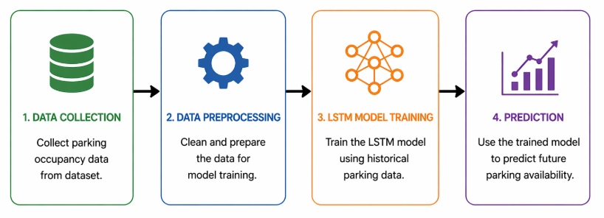
METHODOLOGY
Notes:
2

Slide 6
DATASET DESCRIPTION
Dataset Used
Smart Parking Usage and Occupancy Analytics Dataset
Dataset Features
Date and Time
Parking Zone
Vehicle Type
Available Slots
Occupancy Rate
Violation Reported
Parking Duration
Dataset Purpose
The dataset contains historical parking records that help the model learn parking patterns and predict future availability.

Slide 7
MODULES
Data collection module gathers parking data. It stores historical records.
Preprocessing module cleans data. It removes noise and errors.
Model training module builds the LSTM model. It learns patterns.
Prediction module generates results. It shows future availability.
Notes:
2

Slide 8
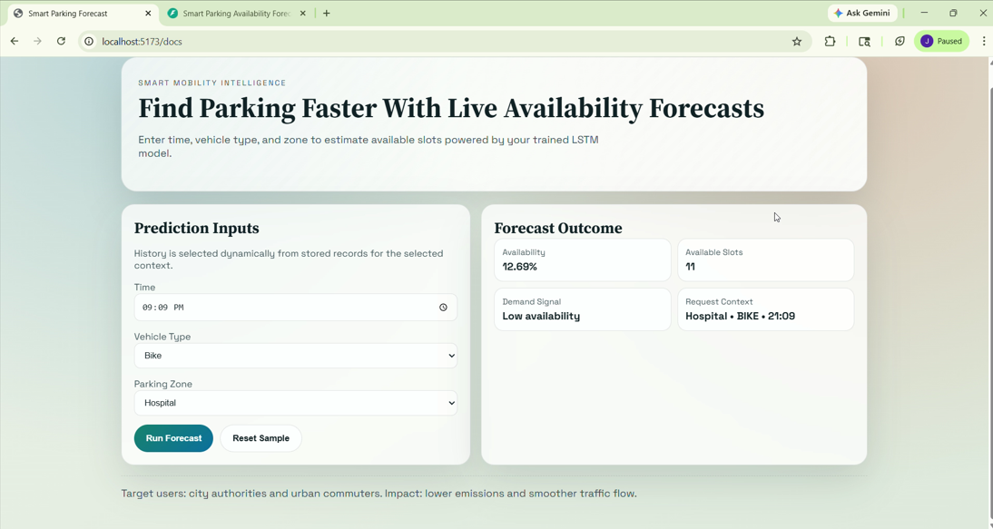
SCREENSHOTS
Notes:
2

Slide 9
PERFORMANCE METRICS
Mean Squared Error (MSE)
Measures prediction error between actual and predicted values.
R² Score
Measures model accuracy and prediction quality.
Formula
MSE = Σ(Actual − Predicted)² / n
R² Score ranges between 0 and 1.
Higher R² and lower MSE indicate better performance.
Notes:
2

Slide 10
RESULTS ACHIEVED
The system uses LSTM for prediction. It is suitable for time-series data analysis.
It processes historical parking data. This helps in identifying patterns and trends.
The model predicts future parking availability. It provides useful insights to users.
The system is designed to be simple and efficient. It can be extended for real-time use.
Notes:
2

Slide 11
CONCLUSION
The proposed Smart Parking Availability Forecasting system predicts parking slot availability using the LSTM .
The system helps reduce traffic congestion, fuel consumption, and the time spent searching for parking spaces.
The project achieved improved prediction accuracy by using historical parking data and time-series analysis techniques.
This system can be further enhanced with real-time IoT integration, mobile applications, and smart city deployment.
Notes:
2

Slide 12
REFERENCES
IEEE (2021) – Smart Parking System using Machine Learning. The system uses ML techniques to detect and manage parking availability with good accuracy.
Elsevier (2022) – Parking Availability Prediction using Regression Models. The study focuses on predicting parking slots but has limited accuracy.
Springer (2023) – Deep Learning Based Parking Prediction using LSTM. The model handles time-series data effectively and improves prediction performance.
Notes:
2

Slide 13
Thank You
Notes:
2

